Slide 1

ME-11102-Workshop
Dr.R PRABHU SEKAR,
Assistant Professor,
Mechanical Engineering Department,
Motilal Nehru National Institute of Technology Allahabad.

Slide 2
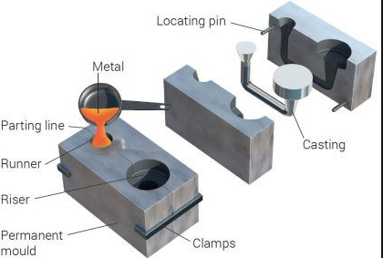
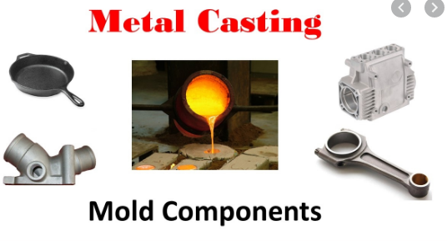
Manufacturing Process
1.Casting Processes

Slide 3
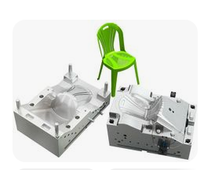
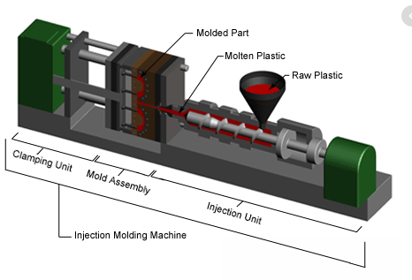
Manufacturing Process
2.Plastics Processing

Slide 4
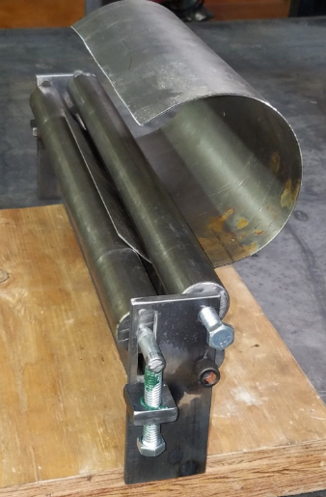
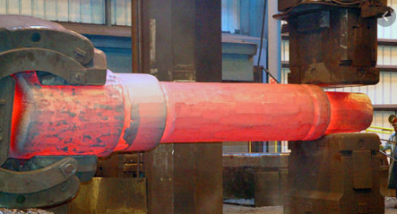
Manufacturing Process
3.Metal working Processes
Rolling
Forging

Slide 5
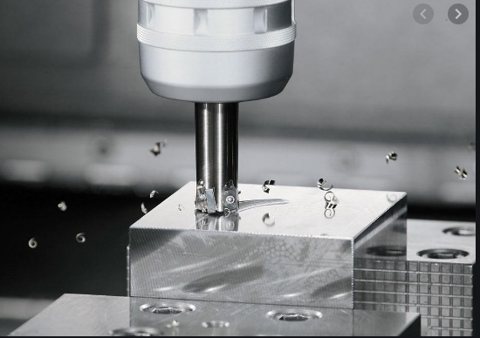
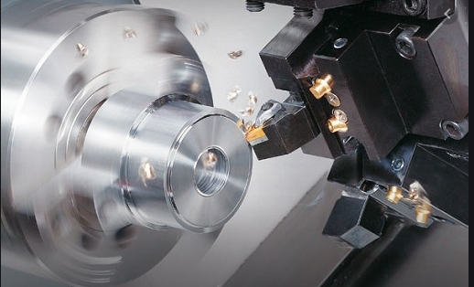
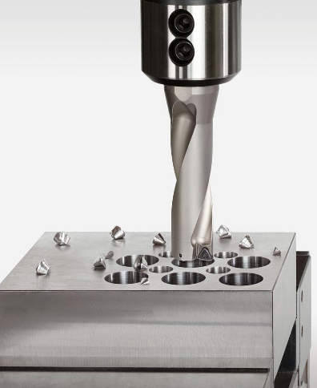
Manufacturing Process
4. Machining Processes
Milling
Turning
Drilling

Slide 6
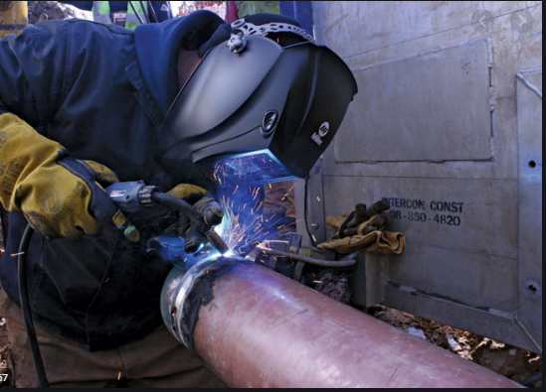
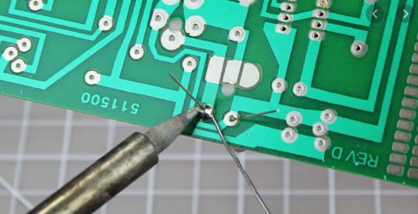
Manufacturing Process
5. Fabrication Processes
Soldering
Welding

Slide 7
Manufacturing Process
1.Casting Process
Casting is a process in which molten metal flows by gravity or other force in to a mold where it solidifies in the shape of the mold cavity.
The principle of casting seems simple: melt the metal, pour it into a mold, and let it cool and solidify;
Shape casting involves the production of more complex geometries that are much closer to the final desired shape of the part or product.

Slide 8
Casting Process

Slide 9
Casting Process
Advantages of casting process
Casting can be used to create complex part geometries, including both external and internal shapes.
Casting can be used to produce very large parts. Castings weighing more than 100 tons have been made.
The casting process can be performed on any metal that can be heated to the liquid state.
Some casting methods are quite suited to mass production.

Slide 10
Casting Process
Disadvantages of casting process
Limitations on mechanical properties,
Porosity,
Poor dimensional accuracy and surface finish for some casting processes,
Safety hazards to humans when processing hot molten metals, and environmental problems.

Slide 11
Casting Process
Casting Products
Parts made by casting processes range in size from small components weighing only a few ounces up to very large products weighing tons.
The list of parts includes dental crowns, jewelry, statues, wood-burning stoves, engine blocks and heads for automotive vehicles, machine frames, railway wheels, frying pans, pipes, and pump housings.
All varieties of metals can be cast, ferrous and nonferrous.

Slide 12

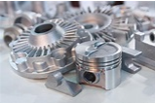
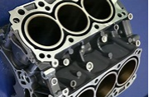

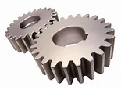
Casting Process

Slide 13
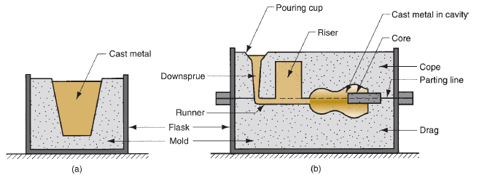
Casting Process
(a) open mold, simply a container in the shape of the desired part;
(b) Closed mold, in which the mold geometry is more complex
The mold contains a cavity whose geometry determines the shape of the cast part.

Slide 14
Casting Process
The actual size and shape of the cavity must be slightly oversized to allow for shrinkage that occurs in the metal during solidification and cooling.
Different metals undergo different amounts of shrinkage, so the mold cavity must be designed for the particular metal to be cast if dimensional accuracy is critical.
To accomplish a casting operation, the metal is first heated to a temperature high enough to completely transform it into a liquid state.
It is then poured, or otherwise directed, into the cavity of the mold.

Slide 15
Casting Process
In an open mold, Fig. (a), the liquid metal is simply poured until it fills the open cavity.
In a closed mold, Fig. (b) a passageway, called the gating system, is provided to permit the molten metal to flow from outside the mold into the cavity.

Slide 16
Casting Process
As soon as the molten metal is in the mold, it begins to cool. When the temperature drops sufficiently (e.g., to the freezing point for a pure metal), solidification begins.
Solidification involves a change of phase of the metal. Time is required to complete the phase change, and considerable heat is given up in the process.
It is during this step in the process that the metal assumes the solid shape of the mold cavity and many of the properties and characteristics of the casting are established

Slide 17
Casting Process
Once the casting has cooled sufficiently, it is removed from the mold.
Depending on the casting method and metal used, further processing may be required.
This may include trimming any excess metal from the actual cast part, cleaning the surface, inspecting the product, and heat treatment to enhance properties.
In addition, machining may be required to achieve closer tolerances on certain part features and to remove the cast surface.

Slide 18
Casting Process
Classification of Casting Process
Expendable mold casting
Permanent mold casting.
An expendable mold means that the mold in which the molten metal solidifies must be destroyed in order to remove the casting.
These molds are made out of sand, and plaster. Sand casting is the most prominent example of the expendable mold processes.
In sand casting, the liquid metal is poured into a mold made of sand.
After the metal hardens, the mold must be sacrificed in order to recover the casting.

Slide 19
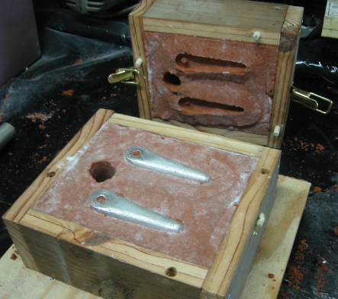
Casting Process
Sand casting

Slide 20
Casting Process
A permanent mold is one that can be used over and over to produce many castings.
It is made of metal (or, less commonly, a ceramic refractory material) that can withstand the high temperatures of the casting operation.
In permanent mold casting, the mold consists of two (or more) sections that can be opened to permit removal of the finished part.
Die casting is the most familiar process in this group.

Slide 21
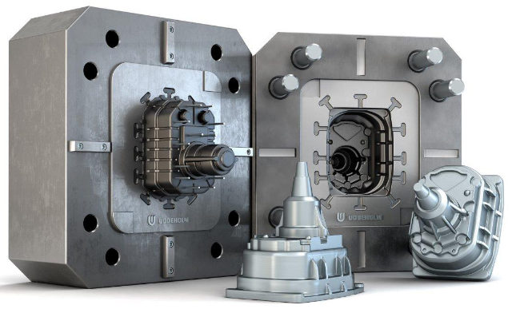
Casting Process
Die casting

Slide 22

Heating and Pouring
Heating furnaces of various kinds are used to heat the metal to a molten temperature sufficient for casting.
The heat energy required is the sum of
The heat to raise the temperature to the melting point,
(2) The heat of fusion to convert it from solid to liquid, and (3) The heat to raise the molten metal to the desired temperature for pouring.
Where, H -total heat required to raise the temperature of the metal to the pouring temperature, J ; ρ density, g/cm³, C_{s} - weight specific heat for the solid metal, J/g-C ; T_{m} -melting temperature of the metal, C; T_{o}-starting temperature—usually ambient, C ; H_{f} - heat of fusion, J/g; C_{l} –weight specific heat of the liquid metal, J/g-C; T_{p} – pouring temperature, C; and V - volume of metal being heated, cm³.

Slide 23
Pouring the Molten metal
After heating, the metal is ready for pouring.
Introduction of molten metal into the mold, including its flow through the gating system and into the cavity, is a critical step in the casting process.
For this step to be successful, the metal must flow into all regions of the mold before solidifying.
Factors affecting the pouring operation include pouring temperature, pouring rate, and turbulence.

Slide 24
Pouring the Molten metal
The pouring temperature is the temperature of the molten metal as it is introduced into the mold.
What is important here is the difference between the temperature at pouring and the temperature at which freezing begins (the melting point for a pure metal or the liquidus temperature for an alloy).
This temperature difference is sometimes referred to as the superheat.
This term is also used for the amount of heat that must be removed from the molten metal between pouring and when solidification commences

Slide 25
Pouring the Molten metal
Pouring rate refers to the volumetric rate at which the molten metal is poured into the mold.
If the rate is too slow, the metal will chill and freeze before filling the cavity.
If the pouring rate is excessive, turbulence can become a serious problem.
Turbulence in fluid flow is characterized by erratic variations in the magnitude and direction of the velocity throughout the fluid.
Turbulent flow should be avoided during pouring for several reasons. It tends to accelerate the formation of metal oxides thus degrading the quality of the casting.

Slide 26


Pouring the Molten metal
The time required to fill a mold cavity of volume V can be estimated as
where TMF - mold filling time, s; V - volume of mold cavity, cm³;
Q - Volumetric flow rate, cm³/s
v - velocity ; A - cross sectional area of the liquid - cm²
h the height of the sprue, cm

Slide 27
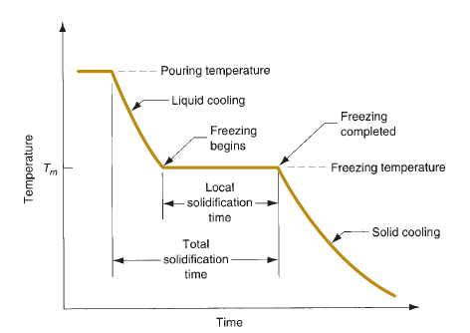
Solidification of metal and alloys
Solidification involves the transformation of the molten metal back into the solid state.
The solidification process differs depending on whether the metal is a pure element or an alloy.
Pure Metals

Slide 28
Solidification of metal and alloys
A pure metal solidifies at a constant temperature equal to its freezing point, which is the same as its melting point.
The actual freezing takes time called the local solidification time in casting, during which the metal’s latent heat of fusion is released into the surrounding mold.
The total solidification time is the time taken between pouring and complete solidification.
After the casting has completely solidified, cooling continues at a rate indicated by the downward slope of the cooling curve.

Slide 29
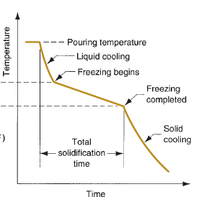
Solidification of Alloys
Most alloys freeze over a temperature range rather than at a single temperature.
The exact range depends on the alloy system and the particular composition.
Cu-Ni alloys

Slide 30

Solidification Time
Whether the casting is pure metal or alloy, solidification takes time.
The total solidification time is the time required for the casting to solidify after pouring.
This time is dependent on the size and shape of the casting by an empirical relationship known as Chvorinov’s rule, which states:
where T_{TS} - total solidification time, min; V - volume of the casting, cm³; A - surface area of the casting, cm² ; n is an exponent usually taken to have a value = 2; and C_{m} is the mold constant.

Slide 31
Solidification Time
Given that n =2, the units of C_{m} are min/cm², and its value depends on the particular conditions of the casting operation, including mold material (e.g., specific heat, thermal conductivity), thermal properties of the cast metal (e.g., heat of fusion, specific heat, thermal conductivity), and pouring temperature relative to the melting point of the metal.
Chvorinov’s rule indicates that a casting with a higher volume-to-surface area ratio will cool and solidify more slowly than one with a lower ratio.

Slide 32
Shrinkage
Shrinkage occurs in three steps:
liquid contraction during cooling prior to solidification;
Contraction during the phase change from liquid to solid, called solidification shrinkage;
Thermal contraction of the solidified casting during cooling to room temperature.

Slide 33
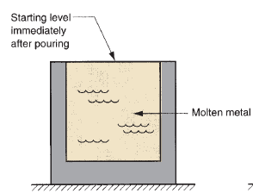
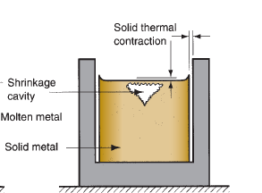
Shrinkage
Further reduction in height and diameter due to thermal contraction during cooling of the solid metal
Starting level of molten metal immediately after pouring;

Slide 34
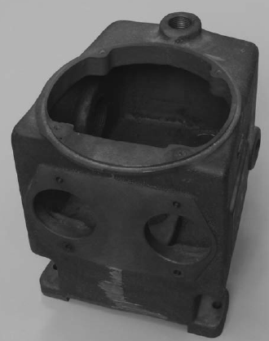
Sand Casting
Sand casting, also known as sand-mold casting, consists of pouring molten metal into a sand mold, allowing the metal to solidify, and then breaking up the mold to remove the casting.
Figure shows a cast iron sand casting of a pump housing that has been partially machined to create accurate holes and surfaces

Slide 35
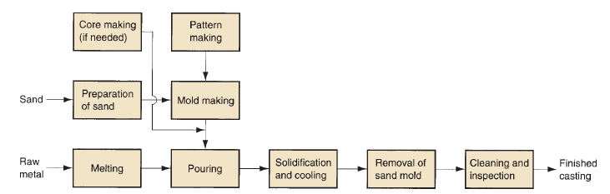
Sand Casting
The cavity in the sand mold is formed by packing sand around a pattern (an approximate duplicate of the part to be cast), and then removing the pattern by separating the mold into two halves.

Slide 36
Sand Casting
The mold also contains the gating and riser system. In addition, if the casting is to have internal surfaces (e.g., hollow parts or parts with holes), a core must be included in the mold. Since the mold is sacrificed to remove the casting, a new sand mold must be made for each part that is produced.

Slide 37
Sand Casting Patterns
Sand casting requires a pattern—a full-sized model of the part, enlarged to account for shrinkage and machining allowances in the final casting.
Materials used to make patterns include wood, plastics, and metals.
Types of Patterns
Solid Pattern
Split Pattern
Match Plate Pattern
Cope and Drag Pattern

Slide 38
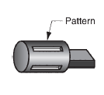
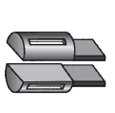
Sand Casting Patterns
The simplest is made of one piece, called a solid pattern—same geometry as the casting
Split patterns consist of two pieces, dividing the part along a plane coinciding with the parting line of the mold. Split patterns are appropriate for complex part geometries and moderate production quantities.

Slide 39
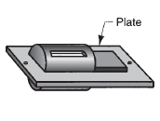
Sand Casting Patterns
For higher production quantities, match-plate patterns or cope-and-drag patterns are used.
In match-plate patterns, the two pieces of the split pattern are attached to opposite sides of a wood or metal plate. Holes in the plate allow the top and bottom (cope and drag) sections of the mold to be aligned accurately.

Slide 40
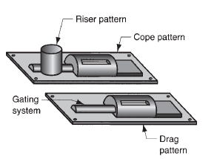
Sand Casting Patterns
Cope-and drag patterns are similar to match-plate patterns except that split pattern halves are attached to separate plates, so that the cope and drag sections of the mold can be fabricated independently, instead of using the same tooling for both.

Slide 41
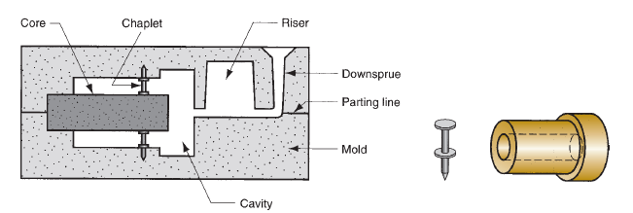
Sand Casting Patterns
Patterns define the external shape of the cast part. If the casting is to have internal surfaces, a core is required.
A core is a full-scale model of the interior surfaces of the part.
It is inserted into the mold cavity prior to pouring, so that the molten metal will flow and solidify between the mold cavity and the core to form the casting’s external and internal surfaces.

Slide 42
Shell molding
Shell molding is a casting process in which the mold is a thin shell (typically 9 mm) made of sand held together by a thermosetting resin binder.
The surface of the shell-mold cavity is smoother than a conventional green-sand mold, and this smoothness permits easier flow of molten metal during pouring and better surface finish on the final casting.
The good finish and accuracy often precludes the need for further machining.

Slide 43
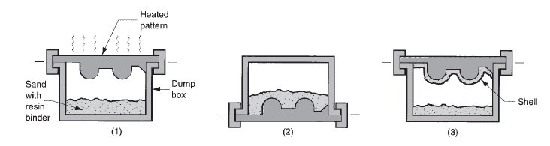
Shell molding
Steps in shell-molding
A match-plate or cope-and-drag metal pattern is heated and placed over a box containing sand mixed with thermosetting resin;
Box is inverted so that sand and resin fall onto the hot pattern, causing a layer of the mixture to partially cure on the surface to form a hard shell;

Slide 44
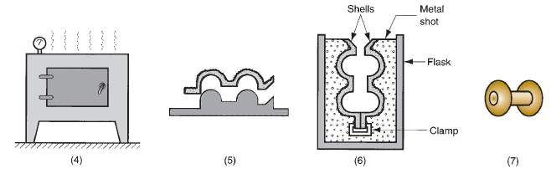
Shell molding
Box is repositioned so that loose, uncured particles drop away;
Sand shell is heated in oven for several minutes to complete curing;
Shell mold is stripped from the pattern;
Two halves of the shell mold are assembled, supported by sand or metal shot in a box, and pouring is accomplished.
The finished casting with sprue removed is shown in fig

Slide 45
Vacuum molding
Vacuum molding, also called the V-process, was developed in Japan around 1970.
It uses a sand mold held together by vacuum pressure rather than by a chemical binder.
Accordingly, the term vacuum in this process refers to the making of the mold rather than the casting operation itself.

Slide 46
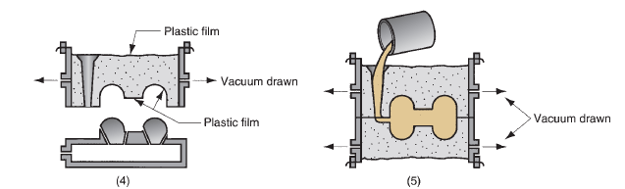
Vacuum molding
Another thin plastic sheet is placed over the fl ask, and a vacuum is drawn that causes the sand grains to be held together, forming a rigid mold;
The vacuum on the mold pattern is released to permit the pattern to be stripped from the mold;

Slide 47
Vacuum molding
This mold is assembled with its matching half to form the cope and drag, and with vacuum maintained on both halves, pouring is accomplished.
The plastic sheet quickly burns away on contacting the molten metal. After solidification, nearly all of the sand can be recovered for reuse.
Because no binders are used, the sand is readily recovered in vacuum molding.
Since no water is mixed with the sand, moisture-related defects are absent from the product.
Disadvantages of the V-process are that it is relatively slow and not readily adaptable to mechanization.

Slide 48
Expanded Polystyrene Process
The expanded polystyrene casting process uses a mold of sand packed around a polystyrene foam pattern that vaporizes when the molten metal is poured into the mold.
The process and variations of it are known by other names, including lost foam process, lost-pattern process, evaporative-foam process, and full-mold process.
Pattern of polystyrene is coated with refractory compound;
Foam pattern is placed in mold box, and sand is compacted around the pattern;

Slide 49
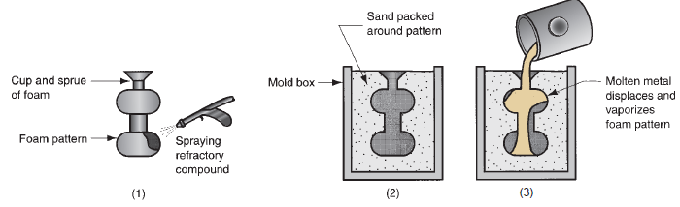
Expanded Polystyrene Process
Molten metal is poured into the portion of the pattern that forms the pouring cup and sprue.
As the metal enters the mold, the polystyrene foam is vaporized ahead of the advancing liquid, thus allowing the resulting mold cavity to be filled.

Slide 50
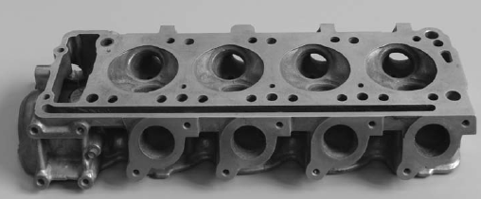
Expanded Polystyrene Process
A new pattern is needed for every casting, so the economics of the expanded polystyrene casting process depend largely on the cost of producing the patterns.
The process has been applied to mass produce castings for automobiles engines.
An aluminum engine head that was cast by the expanded polystyrene process

Slide 51
Investment Casting
In investment casting, a pattern made of wax is coated with a refractory material to make the mold, after which the wax is melted away prior to pouring the molten metal.
The term investment comes from one of the less familiar definitions of the word invest, which is “to cover completely,” this referring to the coating of the refractory material around the wax pattern.
It is a precision casting process, because it is capable of making castings of high accuracy
It is also known as the lost-wax process, because the wax pattern is lost from the mold prior to casting.

Slide 52
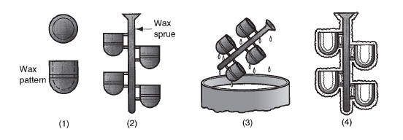
Investment Casting
Steps in investment casting
wax patterns are produced;
Several patterns are attached to a sprue to form a pattern tree;
The pattern tree is coated with a thin layer of refractory material;
The full mold is formed by covering the coated tree with sufficient refractory material to make it rigid;

Slide 53
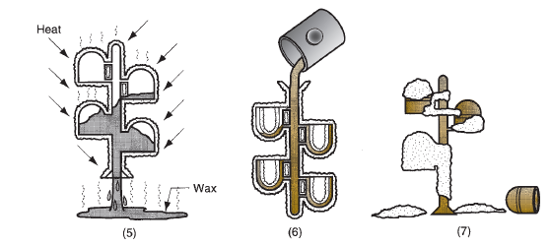
Investment Casting
The mold is held in an inverted position and heated to melt the wax and permit it to drip out of the cavity;
The mold is preheated to a high temperature, which ensures that all contaminants are eliminated from the mold;

Slide 54
Investment Casting
It also permits the liquid metal to flow more easily into the detailed cavity; the molten metal is poured; it solidifies;
The mold is broken away from the finished casting. Parts are separated from the sprue.
Coating with refractory (step 3) is usually accomplished by dipping the pattern tree into a slurry of very fi ne grained silica or other refractory (almost in powder form) mixed with plaster to bond the mold into shape.
The small grain size of the refractory material provides a smooth surface and captures the intricate details of the wax pattern. The final mold is accomplished by repeatedly dipping the tree into the refractory slurry or by gently packing the refractory around the tree in a container.
The mold is allowed to air dry for about 8 hours to harden the binder.

Slide 55
Investment Casting
Advantages of investment casting include:
(1) Parts of great complexity can be cast;
(2) Close dimensional control—tolerances
(3) Good surface finish is possible;
(4) The wax can usually be recovered for reuse; and
(5) Additional machining is not normally required— this is a net shape process.

Slide 56
Die Casting
DIE CASTING
Die casting is a permanent-mold casting process in which the molten metal is injected into the mold cavity under high pressure. Typical pressures are 7 to 350 Mpa.
The pressure is maintained during solidification, after which the mold is opened and the part is removed. Molds in this casting operation are called dies; hence the name die casting.
The use of high pressure to force the metal into the die cavity is the most notable feature that distinguishes this process from others in the permanent mold category.
Die-casting operations are carried out in special die-casting machines, which are designed to hold and accurately close the two halves of the mold, and keep them closed while the liquid metal is forced into the cavity.

Slide 57
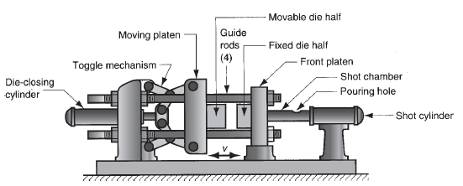
Hot Chamber Machines
Cycle in hot-chamber casting:
With die closed and plunger withdrawn, molten metal flows into the chamber;
Plunger forces metal in chamber to flow into die, maintaining pressure during cooling and solidification;

Slide 58
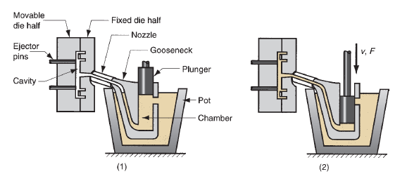
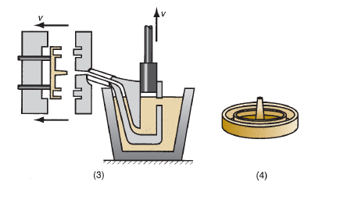
Hot Chamber Machines

Slide 59
Hot Chamber Machines
Plunger is withdrawn, die is opened, and solidified part is ejected.
Finished part is shown in (4).
In hot-chamber machines, the metal is melted in a container attached to the machine, and a piston is used to inject the liquid metal under high pressure into the die.
Typical injection pressures are 7 to 35 MPa.
Production rates up to 500 parts per hour are not uncommon.
Hot-chamber die casting imposes a special hardship on the injection system because much of it is submerged in the molten metal.

Slide 60
Hot Chamber Machines
The process is therefore limited in its applications to low-melting-point metals that do not chemically attack the plunger and other mechanical components.
The metals include zinc, tin, lead, and sometimes magnesium.

Slide 61
Cold Chamber Machines
In cold-chamber die-casting machines, molten metal is poured into an unheated chamber from an external melting container, and a piston is used to inject the metal under high pressure into the die cavity.
Injection pressures used in these machines are typically 14 to 140 MPa .
Compared to hot-chamber machines, cycle rates are not usually as fast because of the need to ladle the liquid metal into the chamber from an external source.
Cold-chamber machines are typically used for casting aluminum, brass, and magnesium alloys

Slide 62
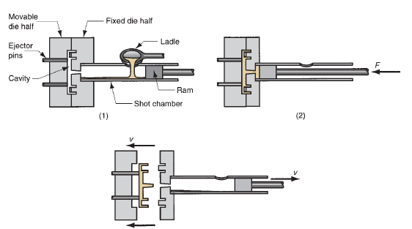
Cold Chamber Machines
Low melting- point alloys (zinc, tin, lead) can also be cast on cold-chamber machines.
Cycle in cold-chamber casting:
With die closed and ram withdrawn, molten metal is poured into the chamber;

Slide 63
Cold Chamber Machines
Ram forces metal to flow into die, maintaining pressure during cooling and solidification
Ram is withdrawn, die is opened, and part is ejected.
Molds used in die-casting operations are usually made of tool steel, mold steel, or maraging steel.
Tungsten and molybdenum with good refractory qualities are also being used, especially in attempts to die cast steel and cast iron.
Dies can be single cavity or multiple-cavity. Ejector pins are required to remove the part from the die when it opens, as shown in the diagrams.
These pins push the part away from the mold surface so that it can be removed.

Slide 64
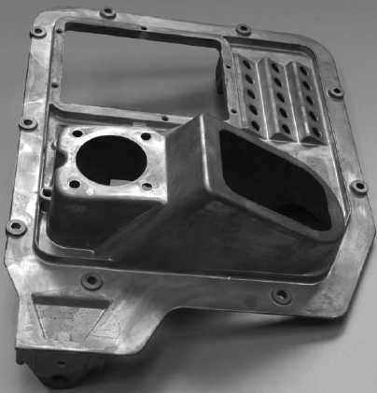
Cold Chamber Machines
A large die casting produced by a cold-chamber machine

Slide 65
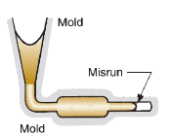
Casting Defects
1. Misruns which are castings that solidify before completely filling the mold cavity.
Typical causes include
fluidity of the molten metal is insufficient,
pouring temperature is too low,
pouring is done too slowly, and/or
Cross section of the mold cavity is too thin.

Slide 66
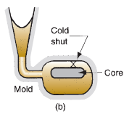
Casting Defects
2. Cold Shuts which occur when two portions of the metal flow together but there is a lack of fusion between them due to premature freezing. Its causes are similar to those of a misrun.

Slide 67
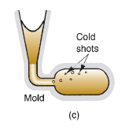
Casting Defects
3. Cold shots, which result from splattering during pouring, causing the formation of solid globules of metal that become entrapped in the casting.
Pouring procedures and gating system designs that avoid splattering can prevent this defect.

Slide 68
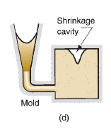
Casting Defects
4. Shrinkage cavity is a depression in the surface or an internal void in the casting, caused by solidification shrinkage that restricts the amount of molten metal
available in the last region to freeze.

Slide 69
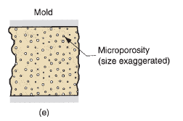
Casting Defects
5. Microporosity consists of a network of small voids distributed throughout the casting caused by localized solidification shrinkage of the final molten metal in the dendritic structure.

Slide 70
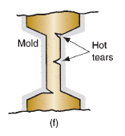
Casting Defects
6. Hot tearing, also called hot cracking, The defect is manifested as a separation of the metal (hence, the terms tearing and cracking) at a point of high tensile stress caused by the metal’s inability to shrink naturally.
In permanent-mold processes, hot tearing is reduced by
removing the part from the mold immediately after solidification.

Slide 71
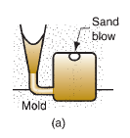
Casting Defects – Sand molding
Sand blow
It is a defect consisting of a balloon-shaped gas cavity caused by release of mold gases during pouring.
It occurs at or below the casting surface near the top of the casting.
Poor venting, and high moisture content of the sand mold are the usual causes.

Slide 72
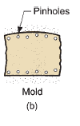
Casting Defects – Sand molding
2. Pinholes, also caused by release of gases during pouring, consist of many small gas cavities formed at or slightly below the surface of the casting.

Slide 73
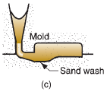
Casting Defects – Sand molding
3. Sand wash, which is an irregularity in the surface of the casting that results from erosion of the sand mold during pouring, and the contour of the erosion is formed in the surface of the final cast part.

Slide 74

Casting Defects – Sand molding
5. Penetration refers to a surface defect that occurs when the fluidity of the liquid metal is high, and it penetrates into the sand mold or sand core.
Upon freezing, the casting surface consists of a mixture of sand grains and metal.
Harder packing of the sand mold helps to alleviate this condition.

Slide 75
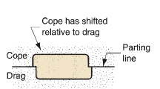
Casting Defects – Sand molding
6. Mold shift refers to a defect caused by a sidewise displacement of the mold cope relative to the drag, the result of which is a step in the cast product at the parting line.

Slide 76

Casting Defects – Sand molding
7. Core shift is similar to mold shift, but it is the core that is displaced, and the displacement is usually vertical.
Core shift and mold shift are caused by buoyancy of the molten metal

Slide 77

Casting Defects – Sand molding
8. Mold crack occurs when mold strength is insufficient, and a crack develops, into which liquid metal can seep to form a “fin” on the final casting.

Slide 78
Blow molding
Blow molding (or moulding) is a manufacturing process for forming and joining together hollow plastic parts.
It is also used for forming glass bottles or other hollow shapes.
The blow molding process begins with melting down the plastic and forming it into a parison and injection stretch blow molding (ISB), a preform.
The parison is a tube-like piece of plastic with a hole in one end through which compressed air can pass.

Slide 79

Blow molding
The parison is then clamped into a mold and air is blown into it. The air pressure then pushes the plastic out to match the mold.
Once the plastic has cooled and hardened the mold opens up and the part is ejected. Water channels are carved into the mold to assist in cooling.

